Slide 1
Language of the Image
Malayna, Sidney, Julia, and Veronika

Slide 2
Types of Photographs

Slide 3
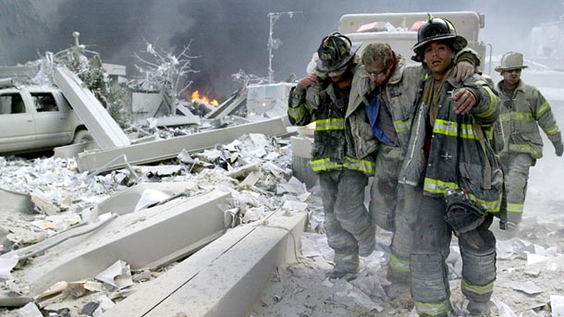
Informational
Aiding the Injured
Todd Maisel

Slide 4
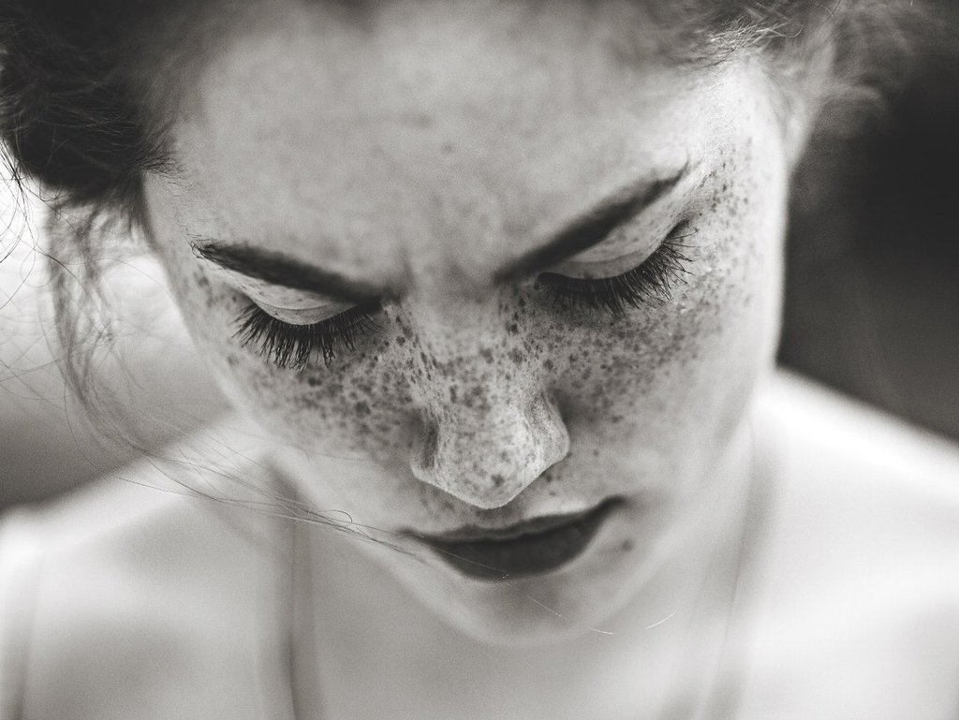
Passive
“My Passive”
Marta Sykro

Slide 5
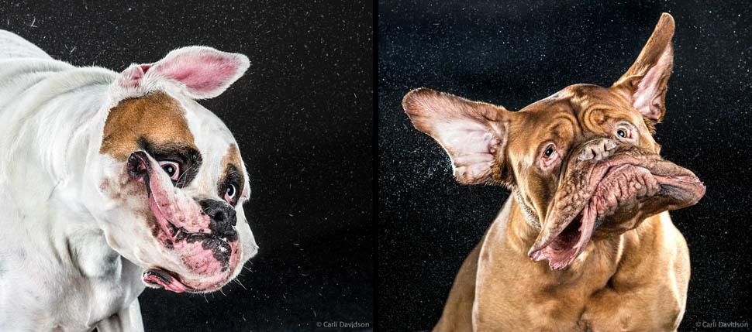
Action
Shaking Dogs
Carly Davidson

Slide 6
Visual Elements

Slide 7
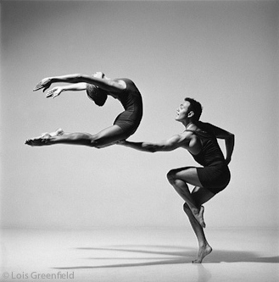
Graphic
Lois Greenfield

Slide 8
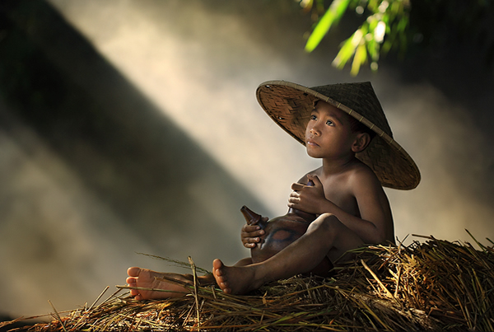
Quality of light
“Think”
Andre Arment

Slide 9
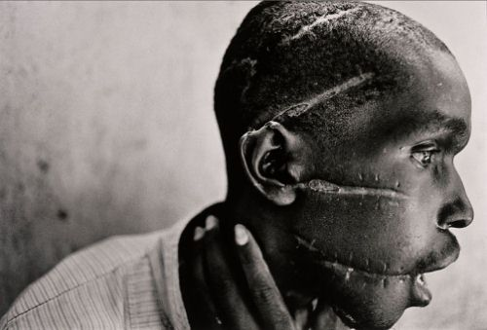
Emotion
“Man mutilated Rwanda”
James Nachtwey

Slide 10
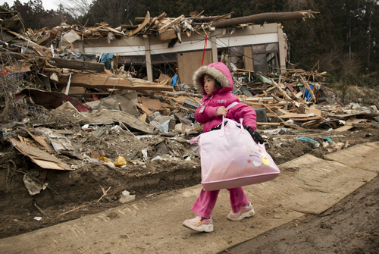
Juxtaposition
Paula Bronstien

Slide 11
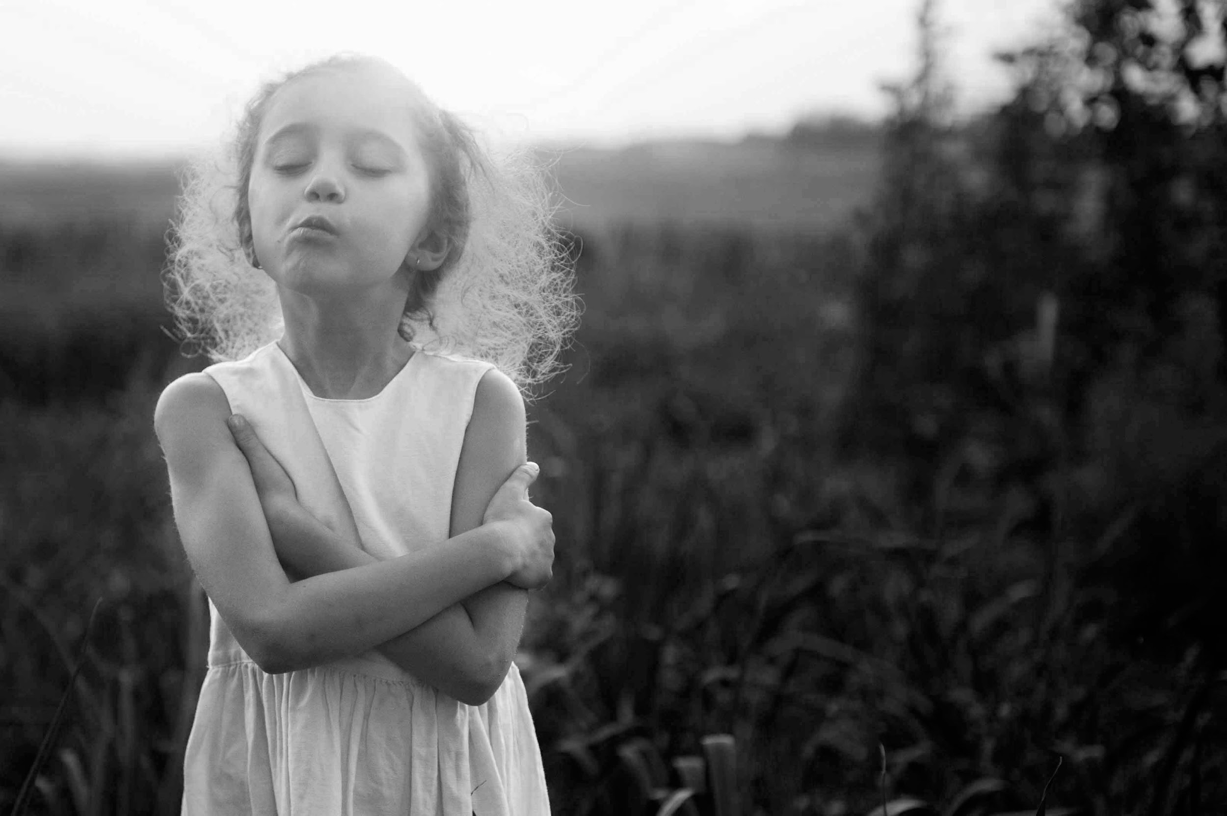
Mood
Vaida Nairn

Slide 12
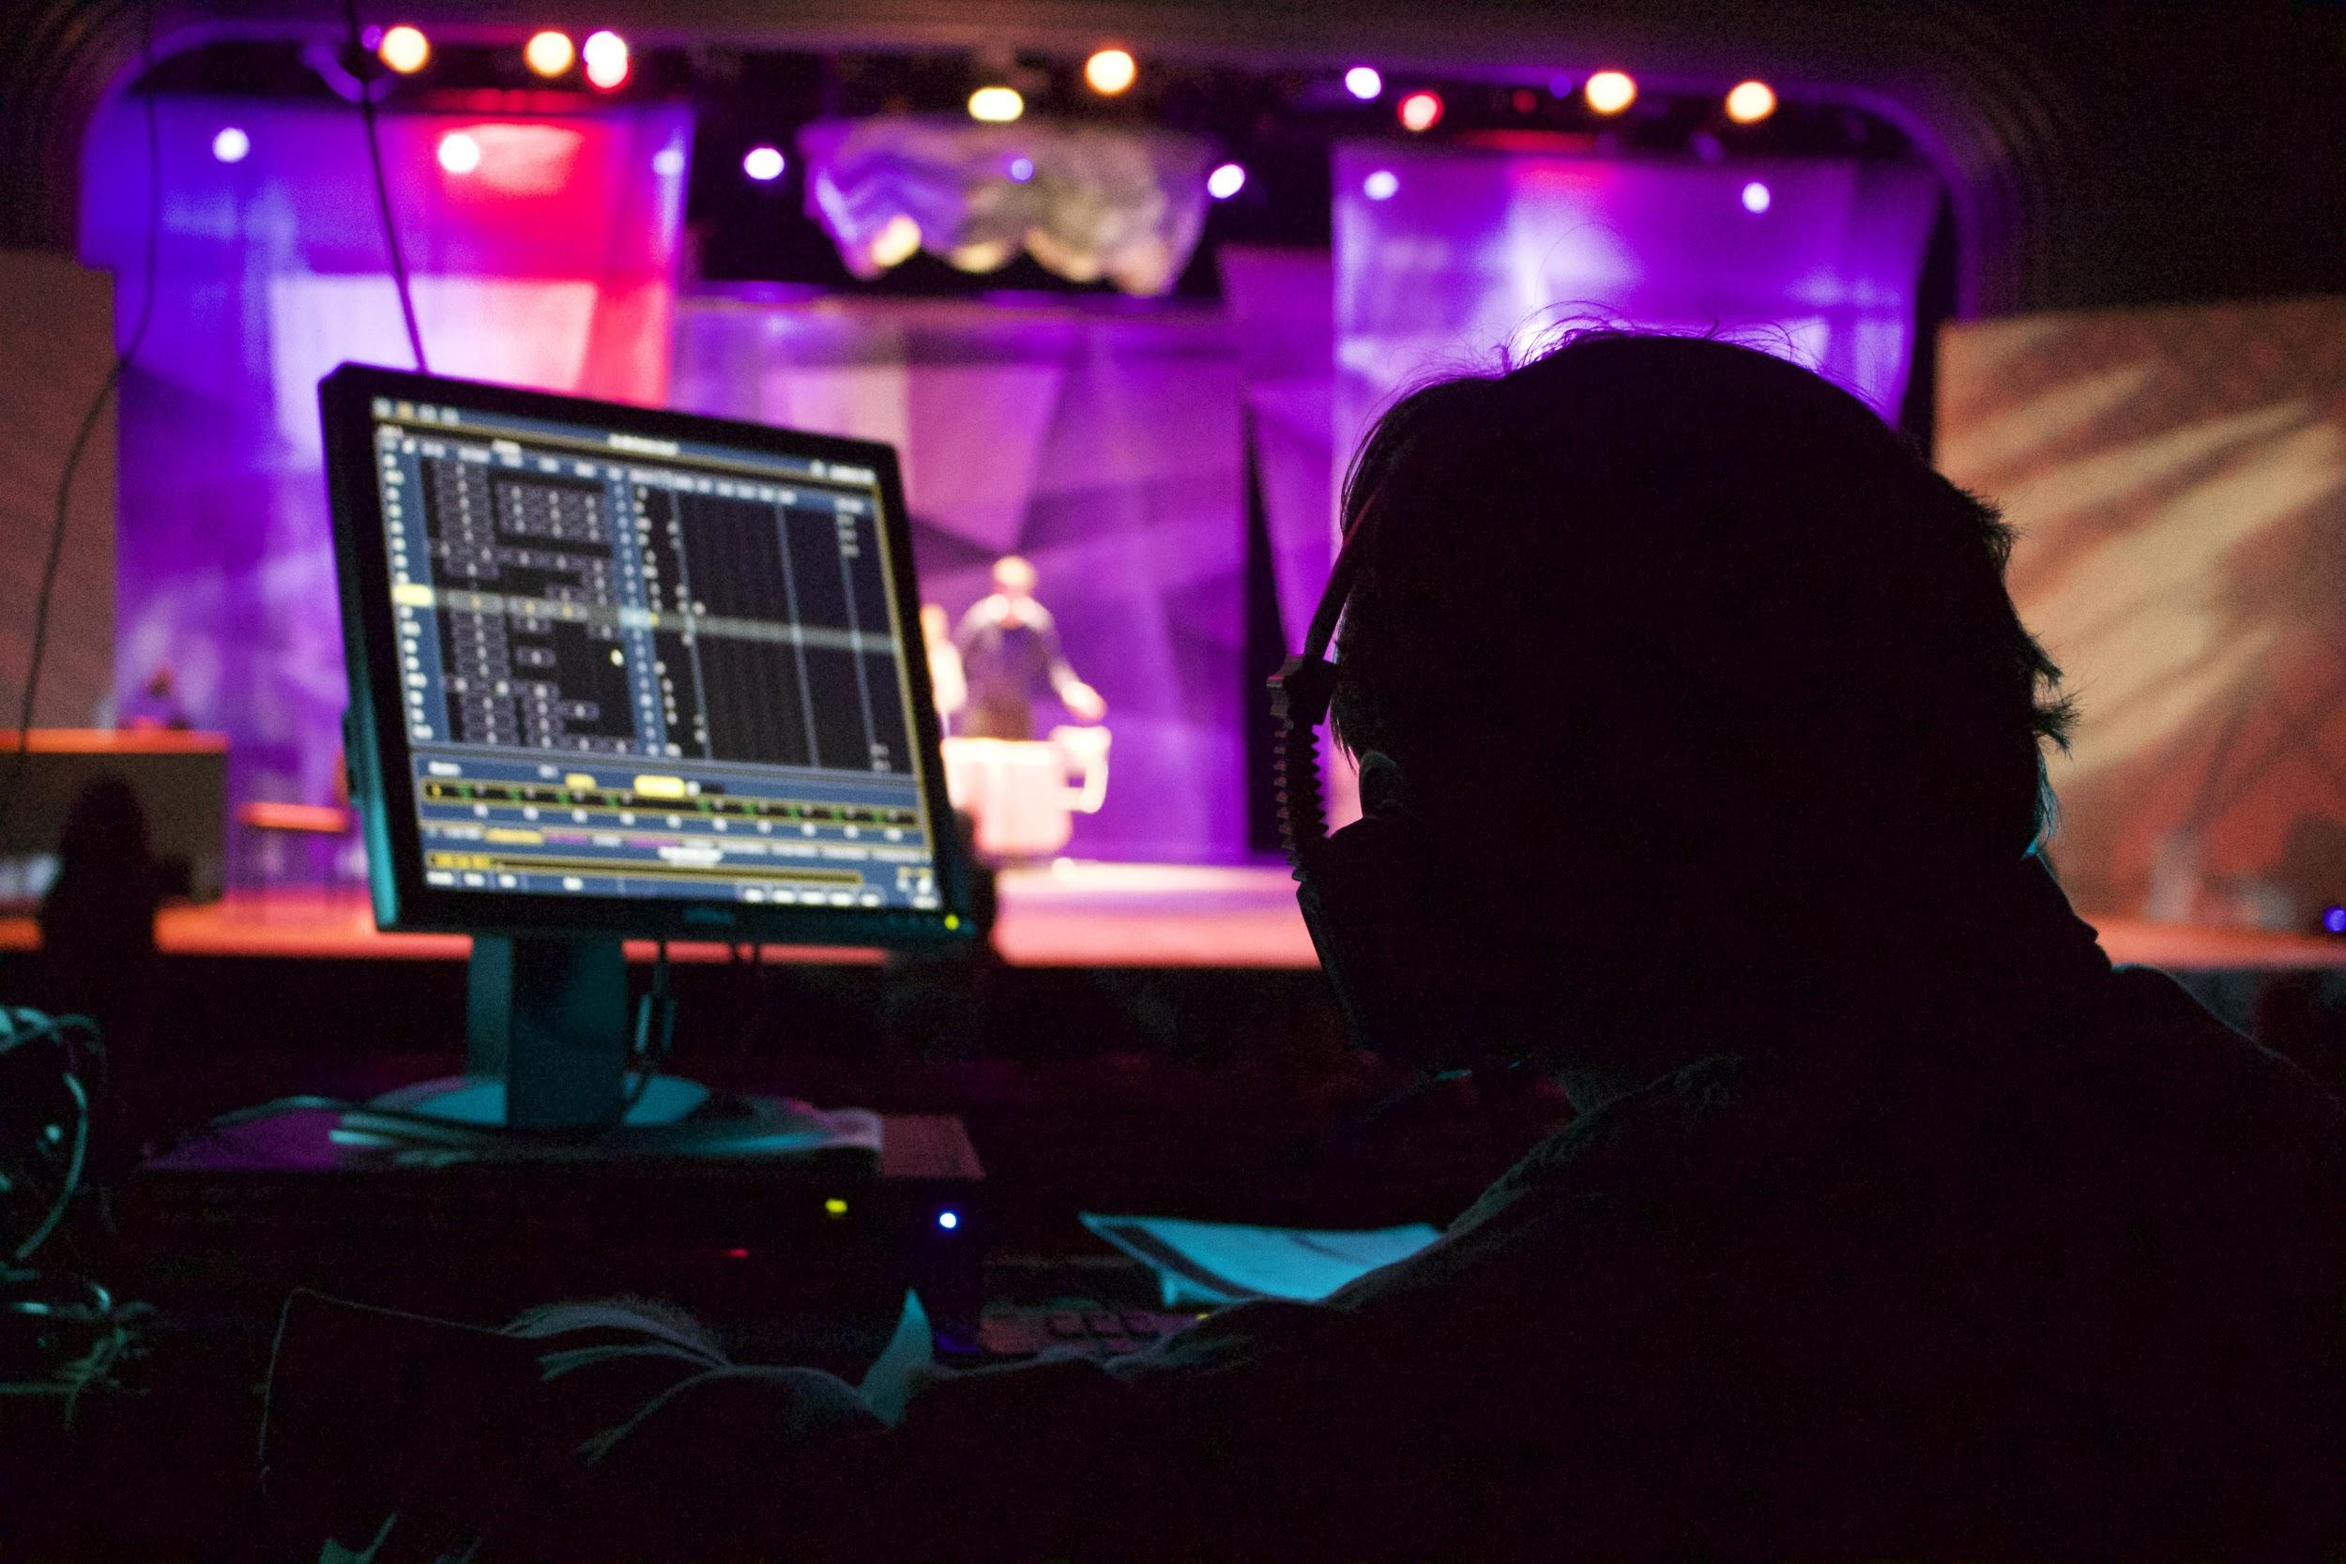
Sense of place
“Person at Work”
Alexander Vavra

Slide 13
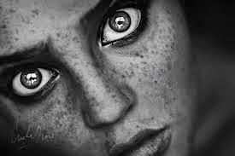
Point of entry
“Strong Subject”
Emily Ewing

Slide 14
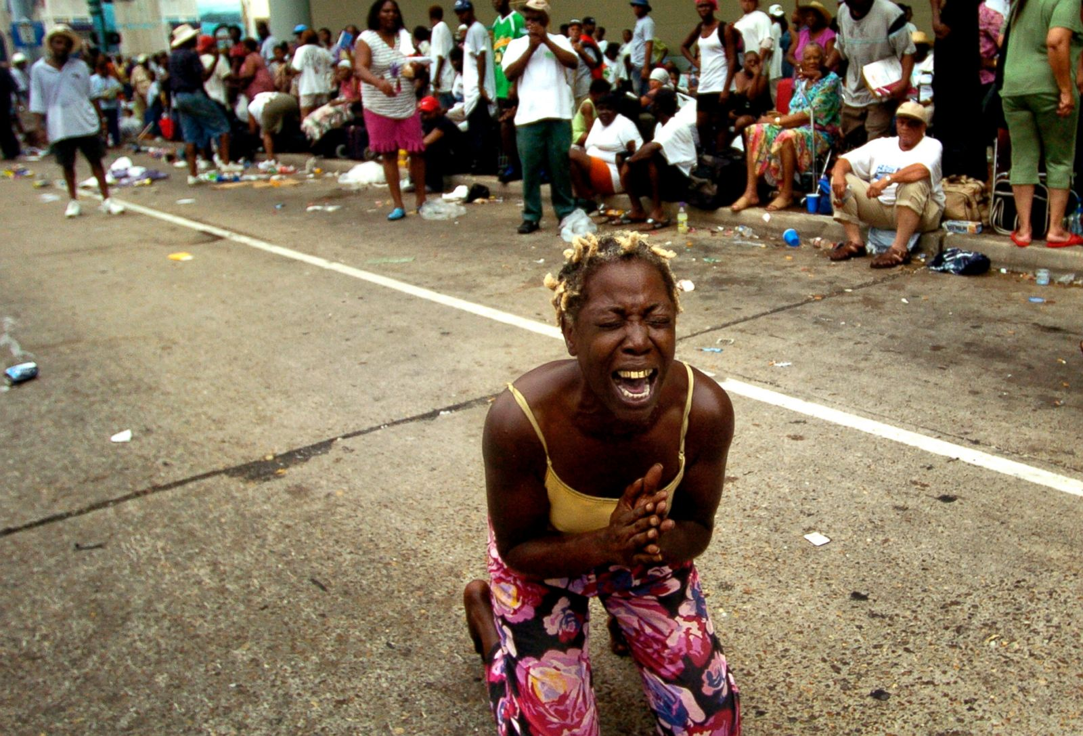
Impact
Ted Jackson/The Times-Picayune/Landov
“Help us, help us please”

Slide 15
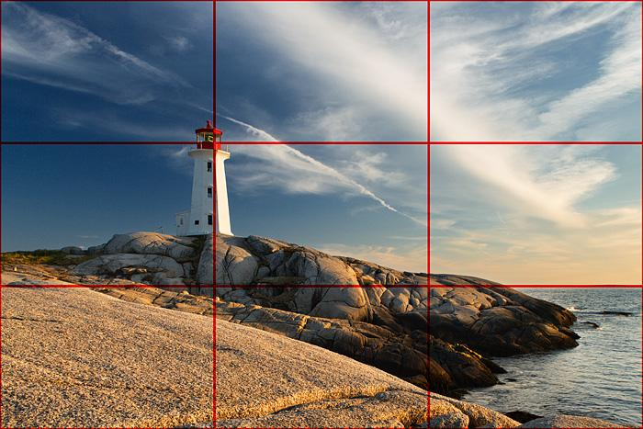
Rule of thirds
Darwin Wigget

Slide 16
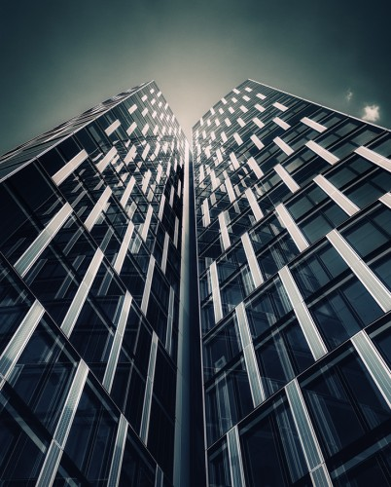
Perspective
Philipp Klinger Photography

Slide 17
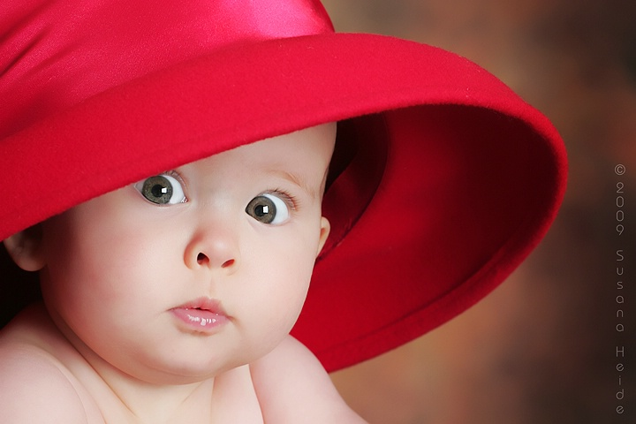
Suprise
Susana Heide
“The Big Surprise”

Slide 18
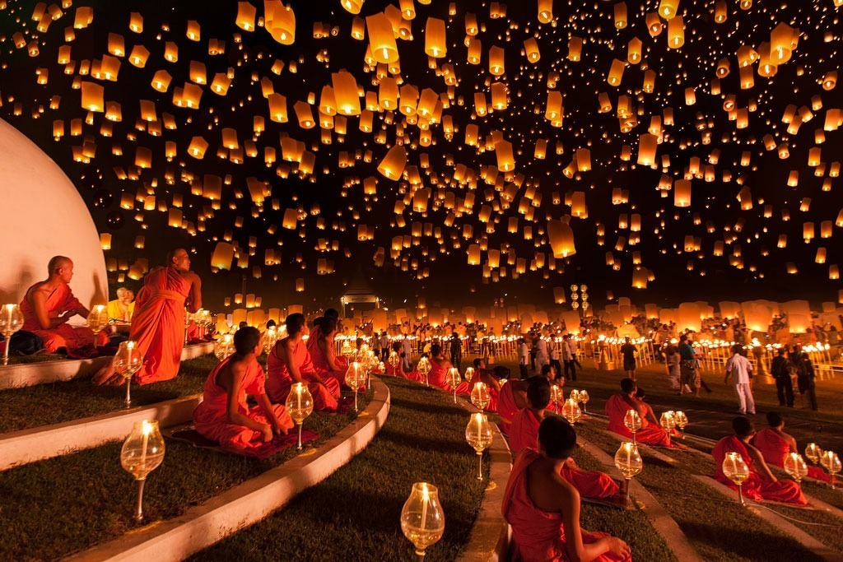
Depth
Ng Chai Hock

Slide 19
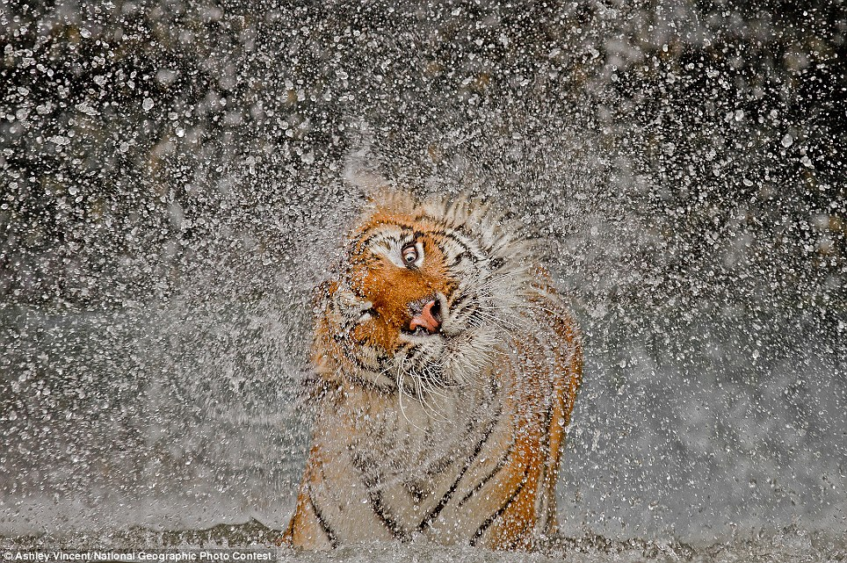
Moment
Ashley Vincent

Slide 20
Different Approaches

Slide 21
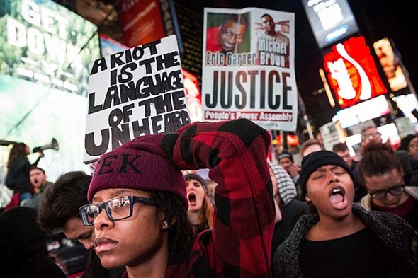
Context
Andrew Burton
Slate
People protest in New York’s Times Square after the Ferguson jury decision

Slide 22
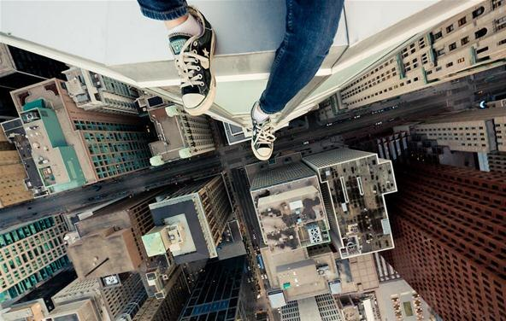
New point of view
Tom Ryaboi
“Rooftopping”

Slide 23
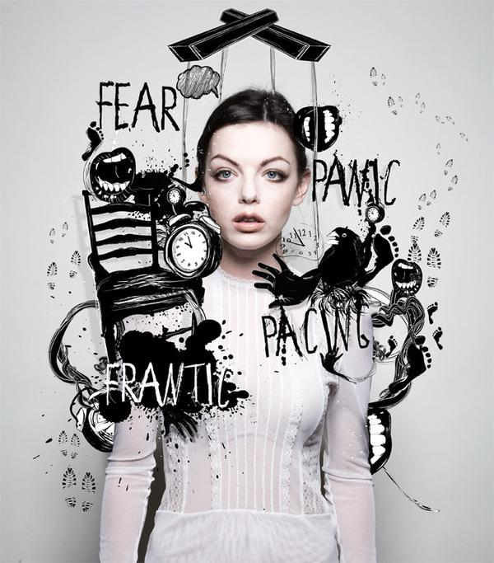
Photographic illustration
Douglas Alves
“Torment/ Cement”

Slide 24
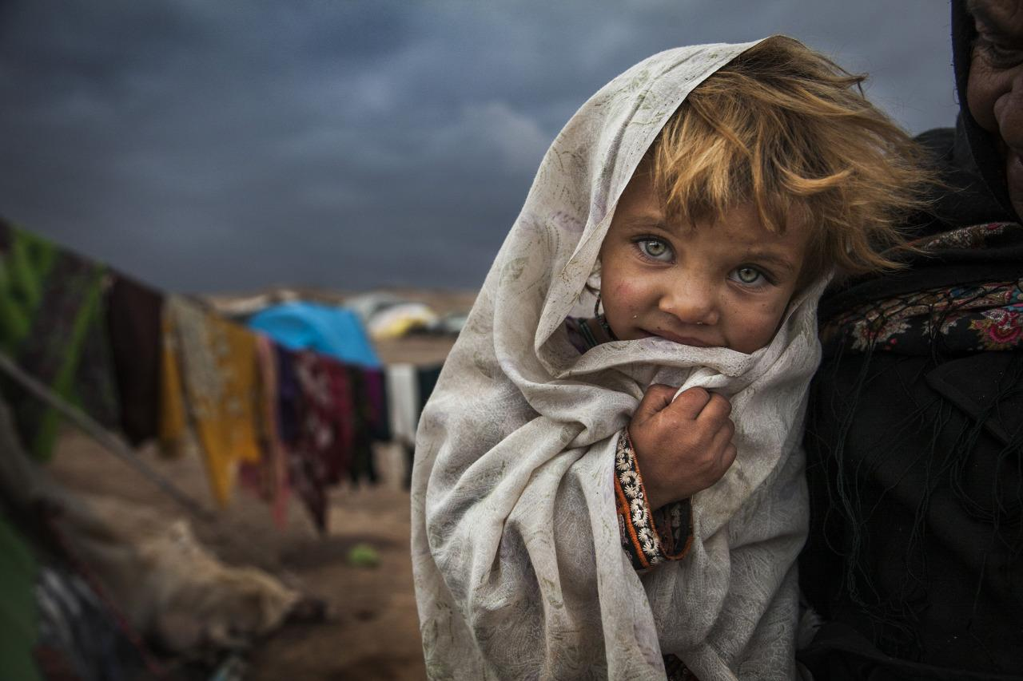
Personality portrait
veronika
Bahareh Mohamadian
National Geographic
Portrait of a Romani girl in camp outside of Torbat Heydariye, Iran

Slide 25
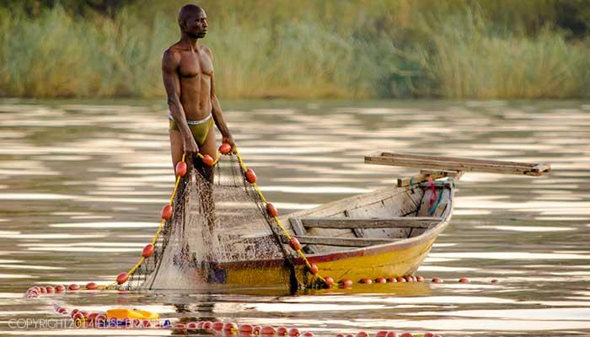
Environmental portrait
Elise Brazier
“Fisherman in Zambia”

Slide 26
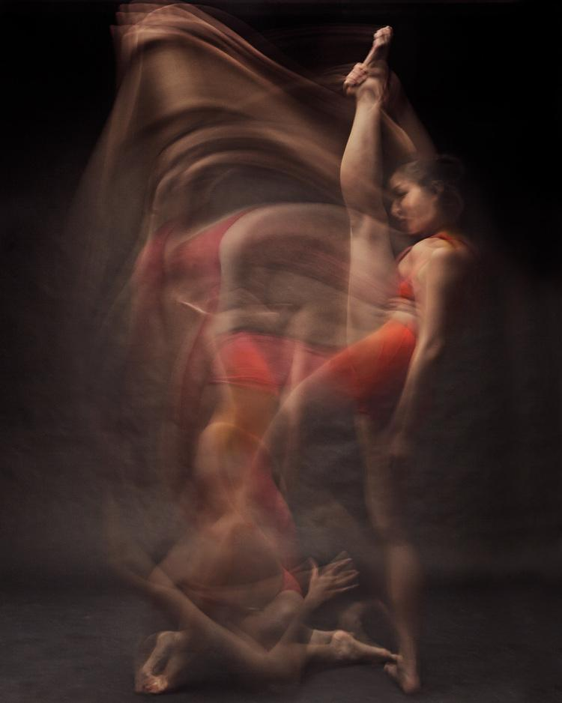
Techniques
Bill Wadman
“Dancers in motion”

